Slide 1
An In‑Depth Analysis of the
Model Context Protocol (MCP)

Slide 2
Agenda
• Integration bottlenecks that birthed MCP
• MCP architecture & primitives
• Ecosystem growth & adoption
• Security & operational challenges
• Future trajectory & recommendations

Slide 3
Why MCP? – The Bottleneck
Custom 'N×M' connectors slowed AI integration
High dev cost, brittle maintenance, vendor lock‑in
Need for a universal, model‑agnostic interface

Slide 4
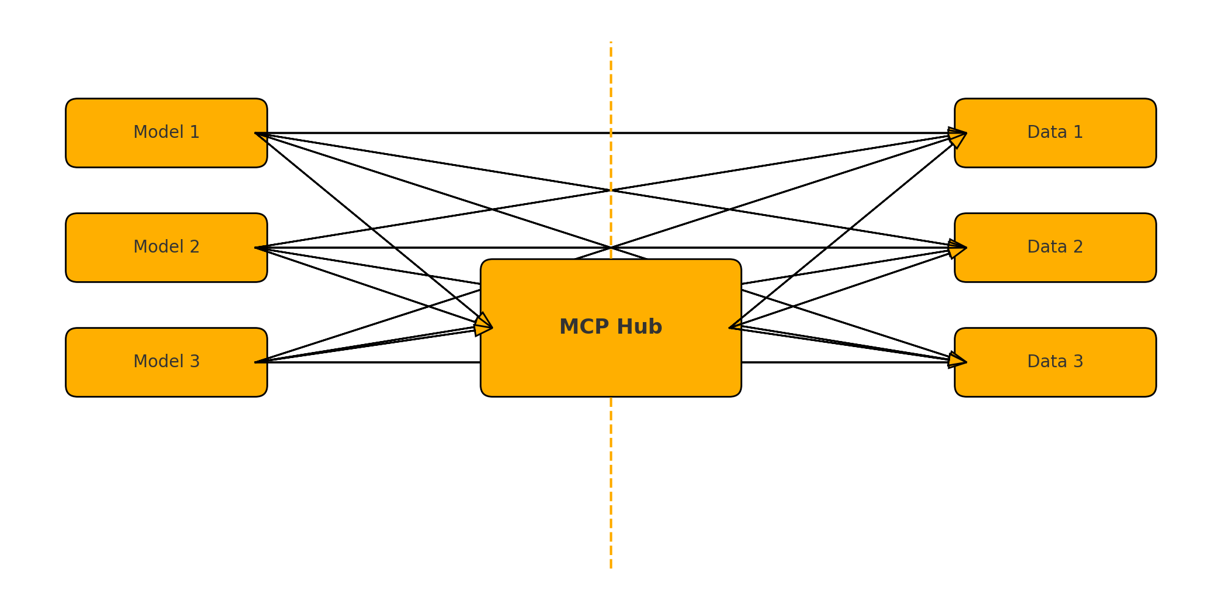
Legacy Integration vs MCP Hub

Slide 5
MCP at a Glance
Open standard introduced by Anthropic (Nov 2024)
Dubbed the “USB‑C for AI” connectivity
JSON‑RPC‑based, stateful sessions
Three roles: Host • Client • Server

Slide 6
Core Architecture: Client‑Host‑Server
• Host – user‑facing app (Claude Desktop, IDEs)
• Client – 1:1 session with a server, enforces policies
• Server – exposes external data/tools via MCP

Slide 7
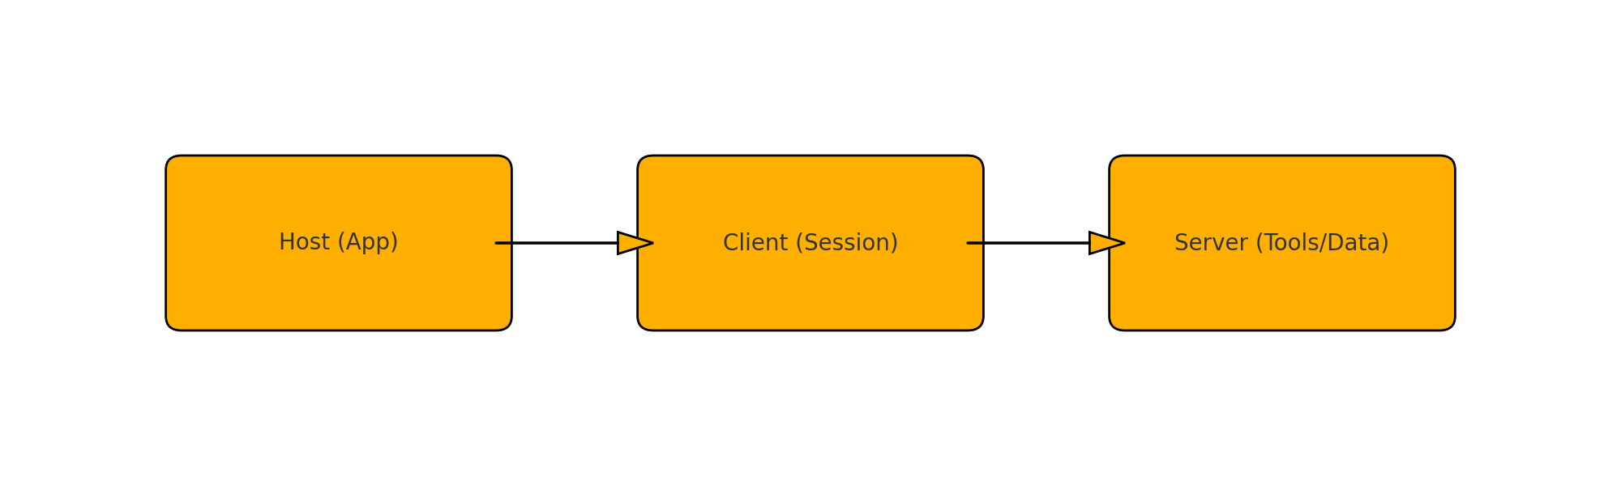
MCP Three‑Tier Architecture

Slide 8
Three Primitives that Power MCP
Prompts – reusable user templates
Resources – read‑only contextual data
Tools – executable functions with side‑effects

Slide 9
Rapid Adoption (2024‑25)
Anthropic, OpenAI, Google DeepMind, Microsoft
AWS, Cloudflare, Replit, GitHub Copilot, Wix
>5 000 open‑source MCP servers listed on Glama

Slide 10
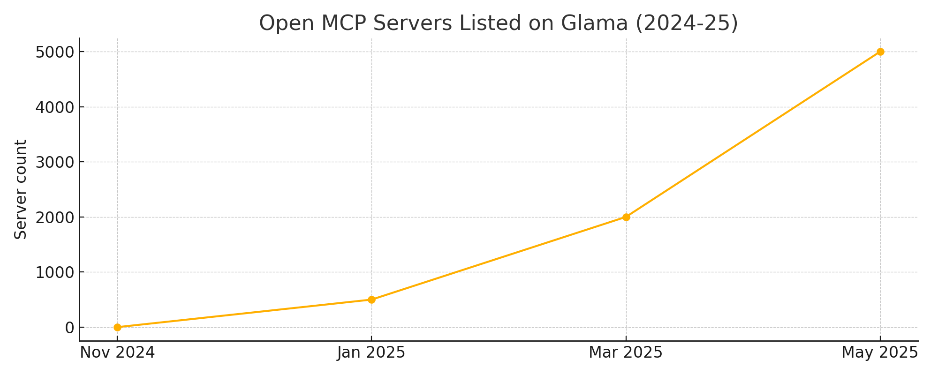
MCP Adoption Timeline (Servers Listed)

Slide 11
Security Landscape
Threats: name collision, toolflow hijack, sandbox escape
Lifecycle risks: creation • operation • update
Mitigations: cryptographic verification, strict perms, audits

Slide 12
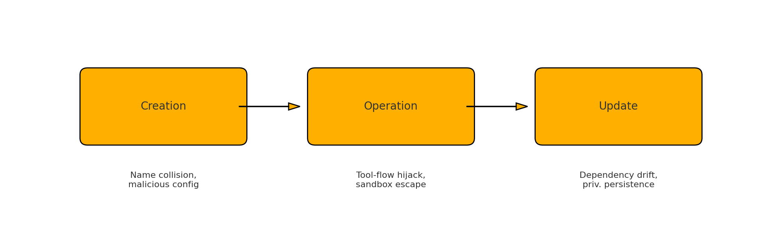
Security Lifecycle: Threats & Mitigations

Slide 13
Operational Challenges
Ecosystem maturity & tooling gaps
Latency / overhead vs direct APIs
Data governance & privacy compliance
Dependency on ecosystem stability

Slide 14
MCP & Related Frameworks
Complements – does not replace – RAG
Provides 'how' of tool calls; agents decide 'what/when/why'
Synergy with LangChain, LlamaIndex, Semantic Kernel

Slide 15
Future Trajectory
Protocol enhancements: OAuth 2.1, full‑duplex streaming
Catalyst for adaptive & decentralized AI networks
Potential AI‑native architectures & new business models

Slide 16
Conclusions & Recommendations
MCP lowers integration friction & boosts contextual AI
Robust security & governance are mission‑critical
Stakeholders: maintainers, developers, researchers, adopters
Shared responsibility to build a trusted ecosystem

Slide 17
Thank You

